Slide 1
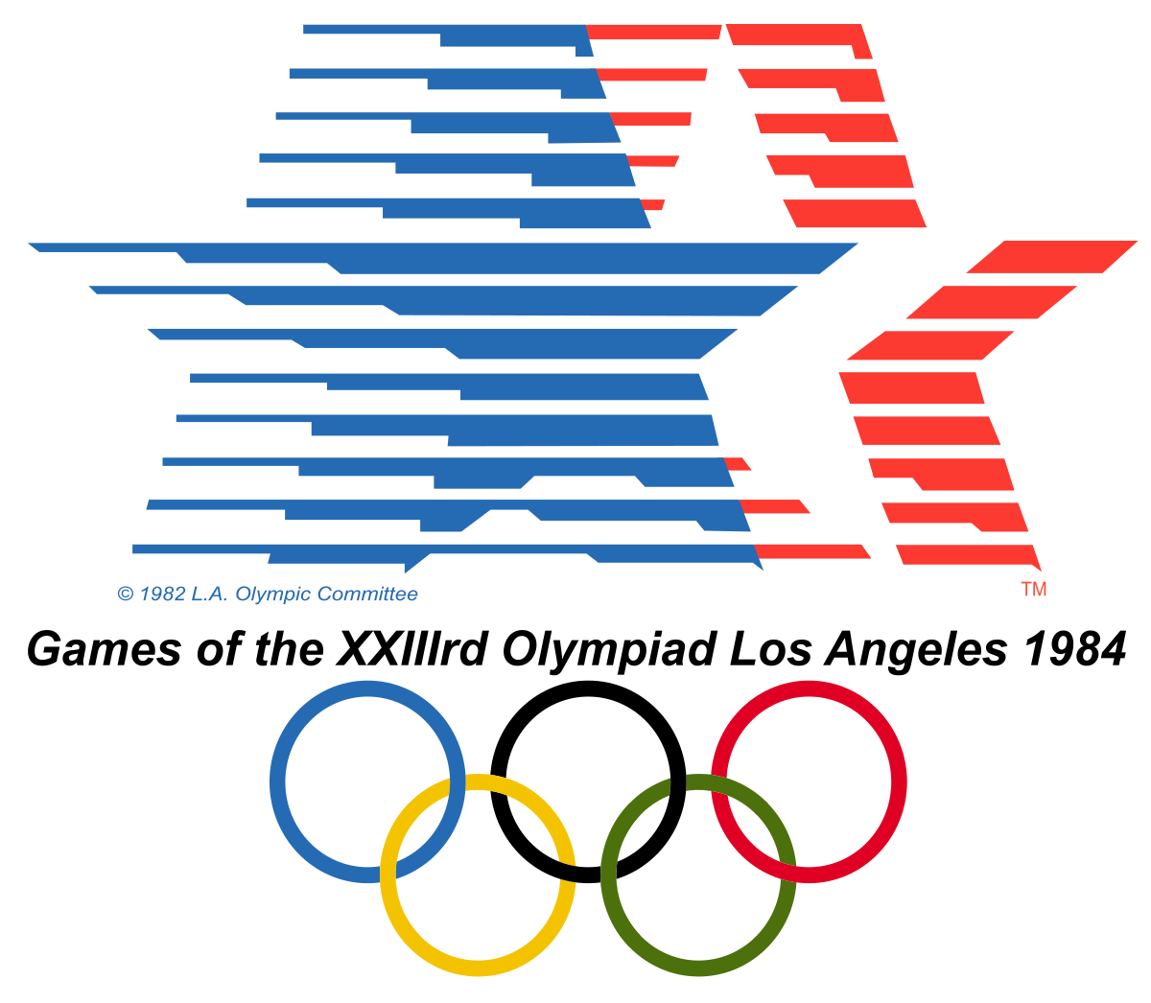
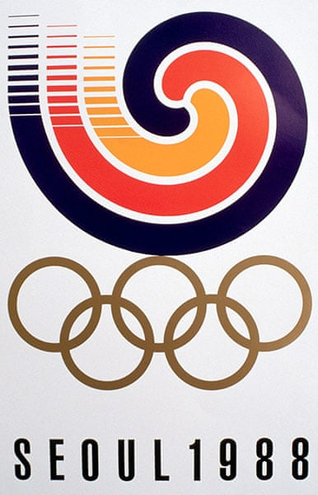
Florence Griffith Joyner
Flo-Jo
American Track & Field Legend
World Record Holder 100m & 200m
Tragic Death in 1998, only 38 years old
Married to Al Joyner – Triple Jump Gold Medalist, 1984 Olympics
USA
Table 3
Ali, Rosana, Chhaya, Victor, Kosta
Notes:
the cause of death was suffocation during a severe epileptic seizure.^{[54] Chhaya next}

Slide 2
Flo-Jo
1984
1988
Notes:
I’m next

Slide 3
Distribution of medals
Medals Won 1984 & 1988
Flo-Jo
It’s either first or second for Flo-Jo…mostly first
USA
Notes:
Rosana NEXT

Slide 4
In 1984 she won 1 silver medal for 200 meters Women competition
In 1988 she competed both individually and as part of a team
In 1988 she won 2 gold for the 100 & 200 meters ; 1 gold for the 100 meters relay. Also, 1 silver for 400 meters relay race.
Notes:
Ali next

Slide 5
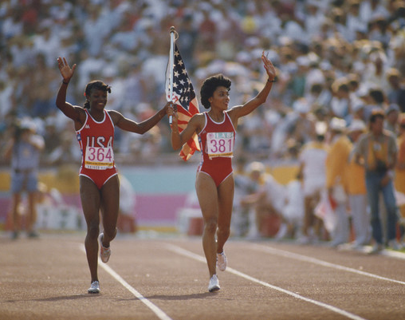
1984 Summer Olympics
August 9, 1984
Women 200 metres
Lost to her American Teammate Valerie Brisco-Hooks
Country | Athlete | Medel
USA | Valerie Brisco-Hooks | Gold
USA | Florence Griffith | Silver
JAM | Merlene Ottey-Page | Bronze
Notes:
Victor Next

Slide 6
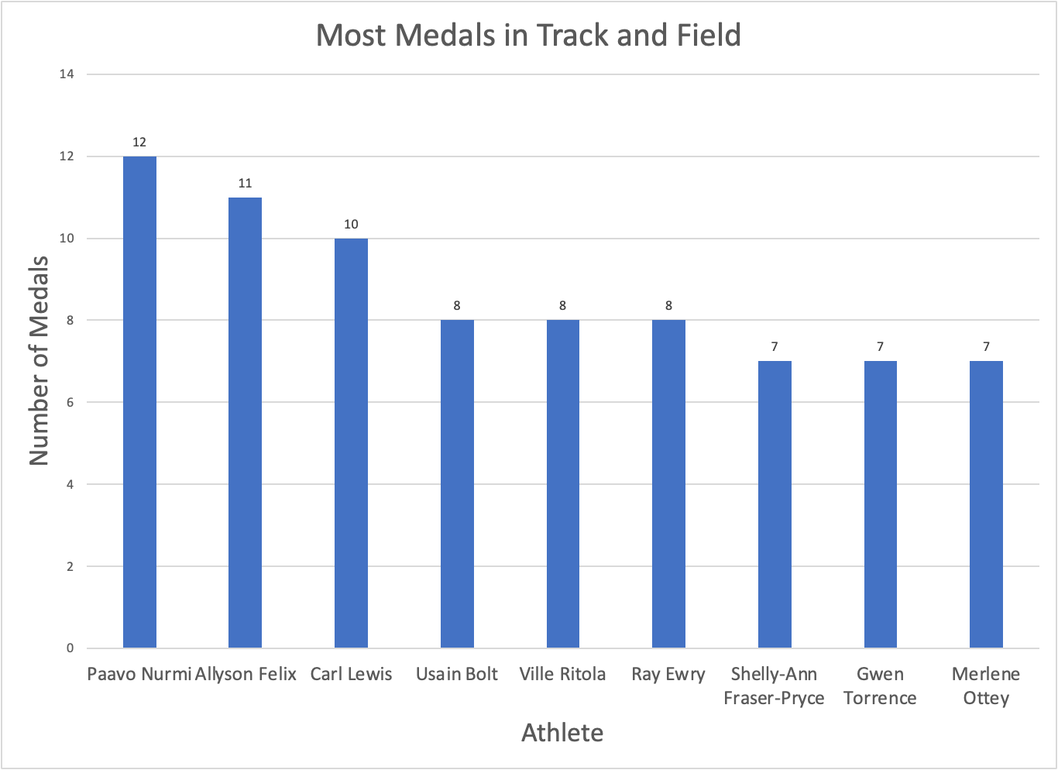
Who is the GOAT of Track and Field?
The GOAT of Track and Field is Paavo Nurmi from Finland, who competed only in the 5,000 meter race.
The sprinters with the most medals are Allyson Felix and Carl Lewis of the United States.
The sprinters with the fastest and medals are Usain Bolt and Shelly-Ann Fraser-Pryce from the dominant Jamaica.
FloJo is not the GOAT of her field, although her two records for 100m and 200m still stand.
Notes:
Victor last

